Slide 1
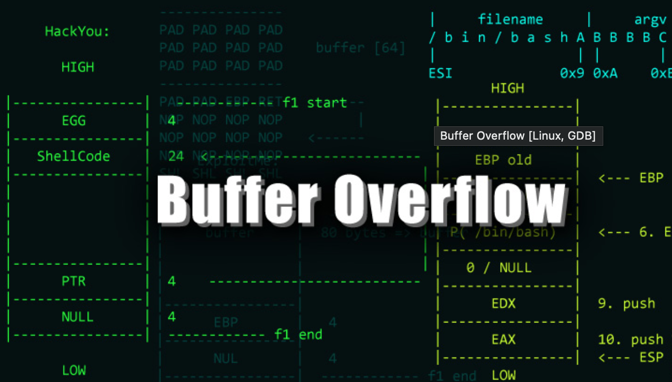
Fares Trad
Dave Patel
Stuti Parmar

Slide 2
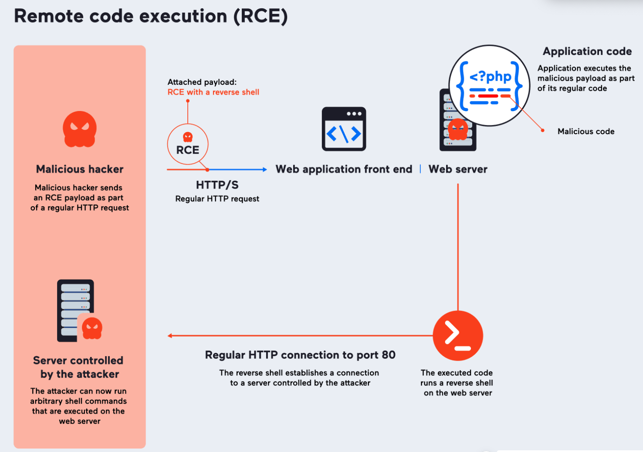
Security Risk (Remote code execution)
The major risk is that if the attacker knows where to inject the malicious code into memory, they are able to redirect the program control flow to execute that code without authorization. For example, if the attacker gains control over the execution of the program with root or admin privileges, they can spread worms across the vulnerable machine.

Slide 3
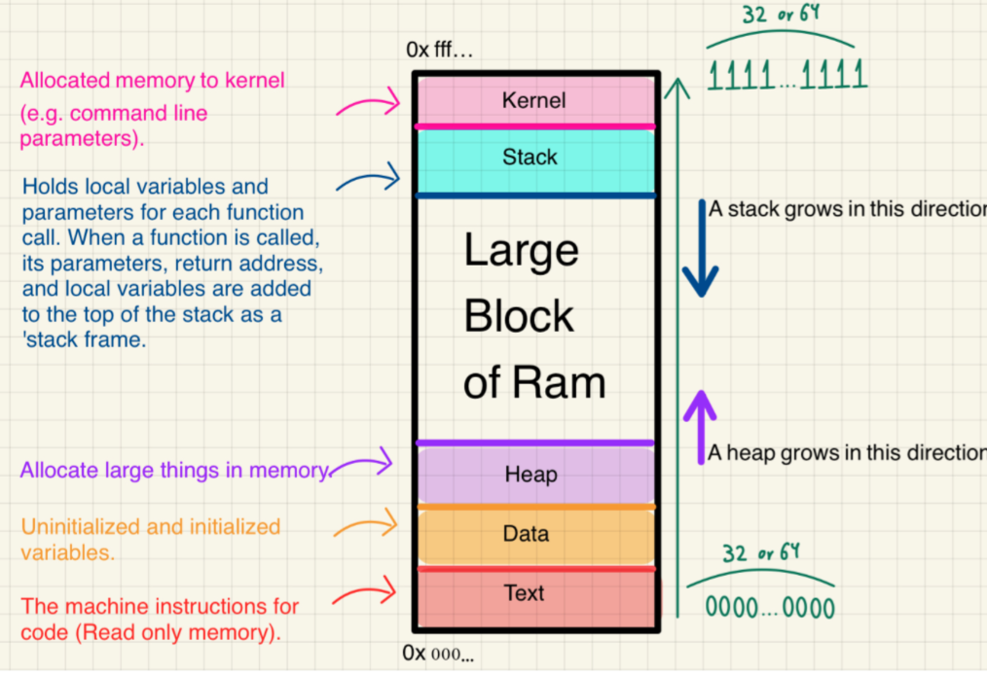
What is Buffer Overflow?
A buffer overflow happens when a program writes more data to a buffer than it can hold. Also occurs when data overflows from one buffer to another, overwriting the memory.
Buffer overflow Attack: When the attacker plays with the coding error to perform malicious tasks. The attacker can change the application exec path and overwrite elements of the memory which could damage existing files or expose data.

Slide 4
Who does this attack Impact?
Companies
All companies can be impacted by buffer overflow attack since buffer overflows are found in software and web applications that almost all companies use nowadays. The exploit can lead to data breaches and/or compromised systems caused by the attacker.
Individuals
Developers using software that is vulnerable to buffer overflow can be affected, especially if that individual is targeted for personal information.

Slide 5
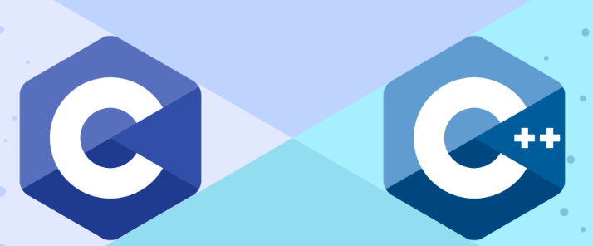
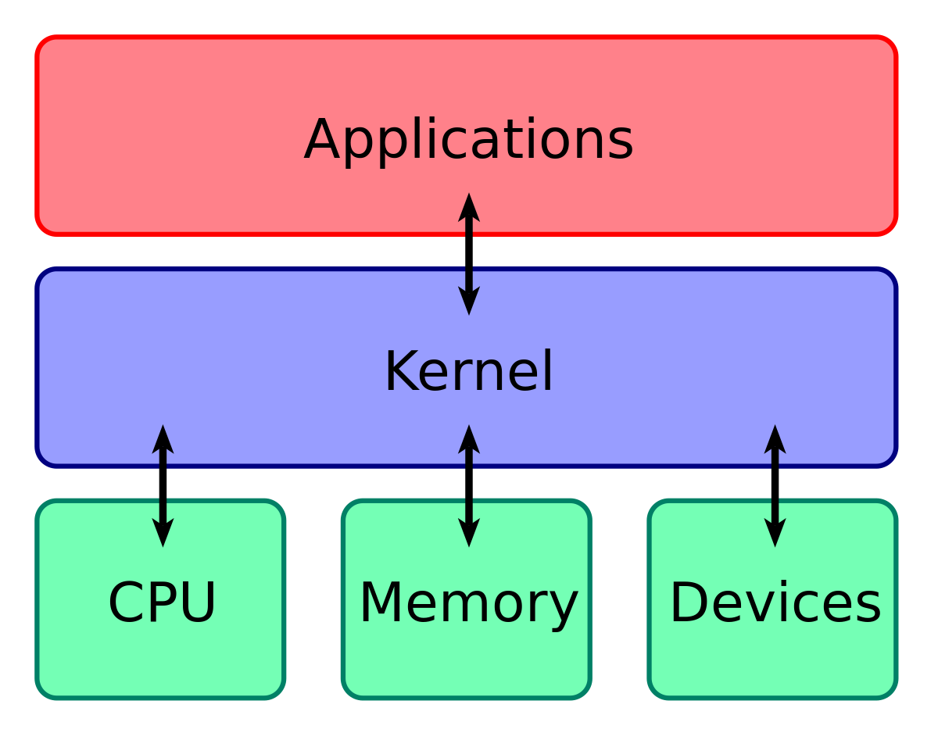
What it impacts?
Applications using C and C++:
Languages such as C and C++ have direct memory access which allows us to directly manipulate memory which provides memory related vulnerabilities. If we allocate a fixed size buffer and we don't properly verify the user input based on the buffer size, buffer overflow can easily occur.
Operating Systems:
The vulnerability exists in OS kernel which is the core of the operating system, it can lead to system crashes and/or remote code execution with root or admin access.
Notes:
rta

Slide 6
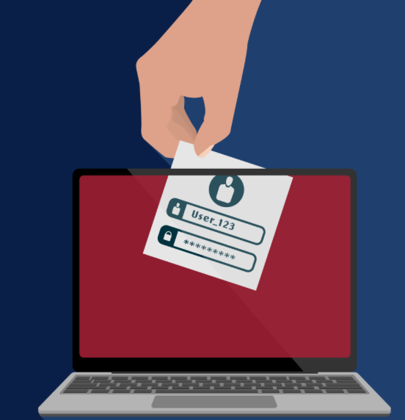
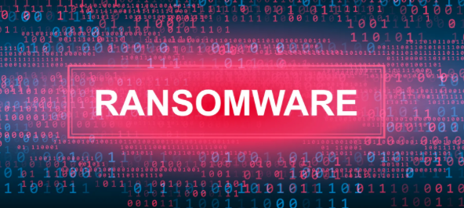
Consequences for organizations/individuals
Organizations:
Data breaches- unauthorized access to customer data and financial data
Financial Loss
Business Disruption - lead to system downtime due to crashed systems
Damage to Reputation- Cause lack of credibility since company is vulnerable
Individuals:
Identity theft- exposed details like social security, address,etce
Financial fraud- could gain information to open fraudulent accounts.
Malware installed- attacker can install malware like keylogger, botnets, ransomware.

Slide 7
Why does buffer overflow exist?
Improper boundary checks and improper input from user:
Programs that deal with buffers(strings or arrays) that fail to check the input size falls within the buffers allocated size. The input data needs to be placed somewhere, so if the input exceeds the size, it causes overflows into other memory areas.
Buffer overflow can exist in stack based overflow (which we will demo), heap based, and string based.
Input that doesn't follow the type of the expected input or malicious input can cause overflow so conditions need to be set in place.

Slide 8
Countermeasures against buffer overflow attack
Bound check: It is important that conditions are set in place to check the users input before we write to its buffer.
Ex. Some functions are safer than others, like strncpy() ensures that no more than the specified number of chars are copied to the buffer, rather than using strcpy() which copies the entire string.
Use languages such as java or python since they manage memory automatically which prevents buffer overflow, whereas C and C++ is more vulnerable.
Address space randomization: Makes it more difficult for attackers to predict memory location for areas such as stack, heap, etc.

Slide 9
Time for the
ATTACK

Slide 10
References
https://www.fortinet.com/resources/cyberglossary/buffer-overflow
https://www.imperva.com/learn/application-security/buffer-overflow/
https://www.cloudflare.com/en-ca/learning/security/threats/buffer-overflow/
https://www.checkpoint.com/cyber-hub/cyber-security/what-is-cyber-attack/what-is-a-buffer-overflow/
https://www.invicti.com/learn/remote-code-execution-rce/
https://www.gtlaw.com.au/knowledge/ransomware-pay-or-not-pay
https://www.ncsc.gov.uk/guidance/data-breaches

